Slide 1

Freedom to Etruaruta
COMPSYS 305
Java Project
Adil bhayani
Sakayan Sitsabesan

Slide 2
Brief backgrounD
Adil Bhayani (Computer Systems Engineering / Computer Science):
Enjoys programming and has dedicated his life to learning as many programming languages
Experience in Java, C and Python
Sakayan Sitsabesan (Computer Systems Engineering):
Main interests are the Internet of Things, microcontroller programming
Experience using Git, C# and developing Mobile Apps

Slide 3
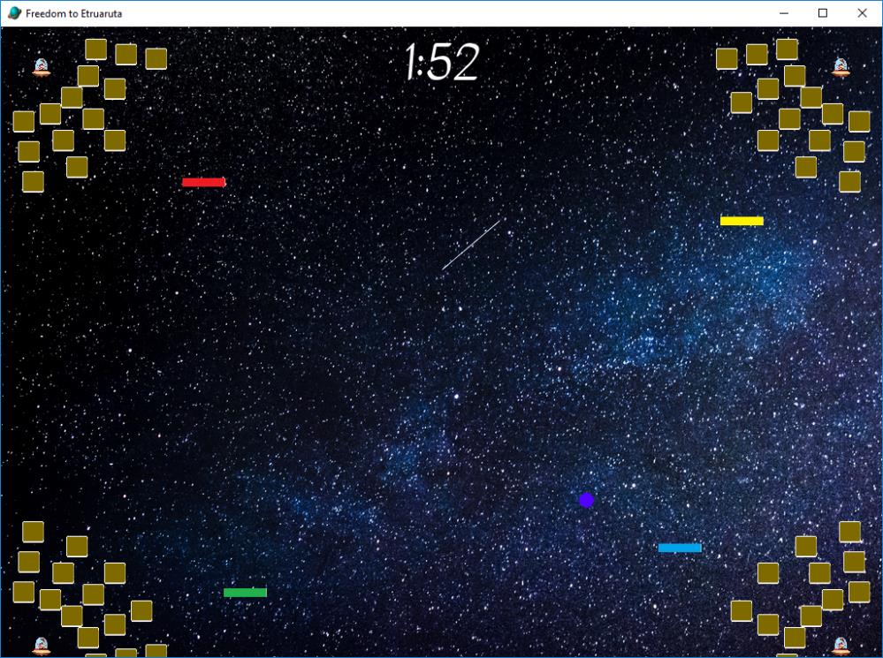
Outline of system
Aim of this project is to implement a pong like game in Java
This is to be achieved using OOP principles and the MVC pattern
Game will involve at least one moving ball that can destroy walls
Player controlled paddle(s) can be used to reflect the ball
Objective is to have as many walls remaining at the end of the game

Slide 4

Campaign OUTLINE
In the year 2600, four races are fighting over the planet Etruaruta
Qeflinda – an Elixr of Immortality - has been found on Etruaruta
Defending the planet from invading races forms the plotline of this game
Immersive cutscenes are used to make the game more engrossing

Slide 5
Top level diagram
High Scores
Views
Controllers
Models
High Score System
Other Views
Ball
Game
Walls
PlayNow
General
Scene Manager
Paddle

Slide 6


requirements
Code compiles & works well under any OS supported by Gradle and Java
Game windows is fixed at 1024 x 768 and no objects exceed this limit
Collisions of balls with paddles, generals, and walls are handled relatively realistically
Game has a two minute time limit and all required keyboard shortcuts are recognized
Background music and Sound FX are included

Slide 7




Special features
Power Ups (Paddle Size up & Ball speed up)
Skills (Catch and Hold ball & Explosive Ball)
Demo Mode (where 4 AIs play each other)
Ghost marker extends gameplay once General dies
Ability to control Powerup placements through the Ghost marker
Adjustable paddle size, number of balls & number of paddles

Slide 8
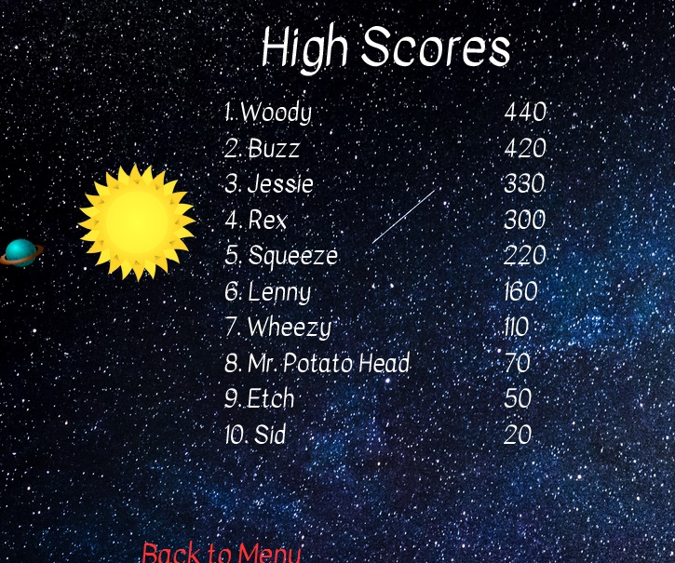
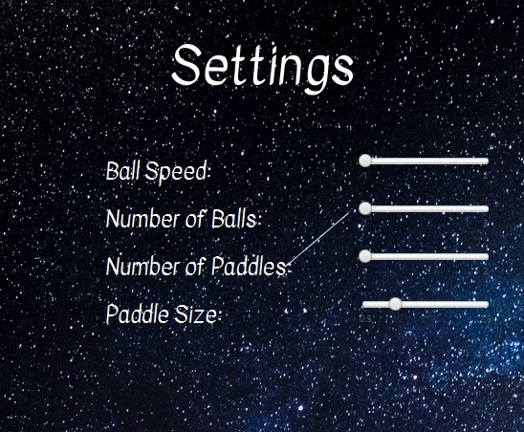
What makes our game different
A settings screen which reflects upon all game modes
Perfect balance of AI difficulty
Customisations to make every game different
Immersive story through the use of embedded videos
High score system which retains data across sessions
Leads to people's sense of competition urging them to continue playing

